Slide 1
The Basics to Programming 5
A Series of Bite Size Lessons for Programming
Arrays, Objects, and Commands
By Tariq Chatur

Slide 2
Introduction
This will be the final lesson before throwing out to the wolves, you should have all the skills needed after this lesson to be able to learn as you go to become a pro
Arrays are ways of storing more than one piece of information in a single variable
Objects are abstract representations of collections of data
Commands are methods than can be called from a system to interact with them

Slide 3
Arrays
Arrays are how we store more than one piece of information into a single variable.
This is very useful when working with lots of data that can be treated the same way, for example, lets say that there are 30 people and their ages we could make 30 variables, one for each person, or we could make one array that stores all 30 ages in one place
With loops and functions we can make working on these data sets quick and conveint

Slide 4
Array Structure
Indexes | 0 | 1 | 2 | 3 | 4 | 5 | 6 | 7 | 8 | 9
Values | A | B | C | D | E | F | G | H | I | J
Arrays are constructed as a list of values with indexes. You can get whatever value you want by referencing its index.
To reference an index we use this structure:
$arrayName[$index]
So if we wanted the value: G
We would call: $arrayName[6]
*It is important to remember that arrays start at index 0, if you want the first value, it is at index 0

Slide 5
Array Construction
To create an array:
$arrayName = value1, value2, value3….
or
$arrayName = @(value1, value2, value3….)
*In powershell these values can be of different types, however other languages may be restricted to a single type
If you want an array that is arrange of numbers you can do:
$arrayName = (1..5)
If you want a multidimensional array:
$arrayName = @(
(value1a, value1b, value1c),
(value2a, value2b, value2c),
(value3a, value3b, value3c)
)
Value1 | Value2 | Value3 | Value4 | …
0 | 1 | 2 | 3 | 4
1a | 1b | 1c
2a | 2b | 2c
3a | 3b | 3c

Slide 6



Array Interaction
-To get a value in a certain position use:
-To set a value in a certain position use:
-To make a copy of an array use:
-To get the length of an array use:
*remember the last index is one less than the length
-To loop through every element of an array use:
or

Slide 7
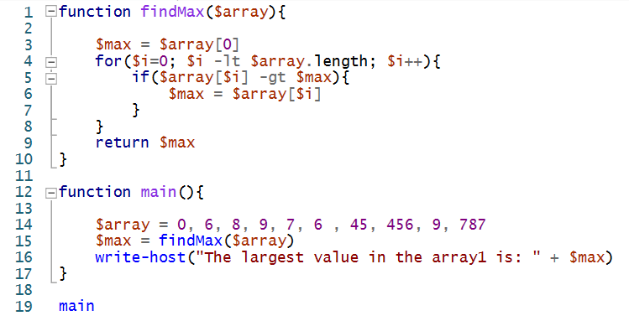
Array Example
This example will highlight a capability of arrays, we will store data in an array and then act on them.
We will take a list of numbers and find the maximum value among them. To do this without an array would require the creation of many variables and likely many additional lines of code to execute, however with an array we can walk through it.

Slide 8
Array Example Review
In this example we are looking for the max value of an array (a list of numbers). We do this by:
Walking through the array one index at a time
If the value is bigger than what we think the biggest value is, replace it
Return the biggest value
Now this is one way to solve the problem, likely the fastest way to do so. But only in an unsorted array.
Another way to solve this problem would be to sort the values and then grab the last one. Sorting is a great method to practice using arrays

Slide 9
Array Exercise
Create a script that sorts an array using Bubble Sort
https://en.wikipedia.org/wiki/Bubble_sort
The array being: 8 65 475 2 58 36 648 1 908 5248 24 3 75 9
But in short, bubble sort works by comparing two numbers and swapping their position if one is the larger one is on the left. In the worst case scenario, every number has to be compared to every number. We call this O(n^2) where n is the length of the array.
Hint: You will use a nested forloop
You can find the template for the code in the file: bubblesort_example.ps1
The answer is provided in the file: bubblesort_solution.ps1

Slide 10
Objects
Objects are abstract representation of things that hold values and can be interacted with. These can be instanced to have a data structure that can be used.
ex. Baseball player = Abstract Object
Jim Bob = Instance of the Object
By making and specifying objects we can use OO(Object Oriented Principles) to create much more complex programs

Slide 11
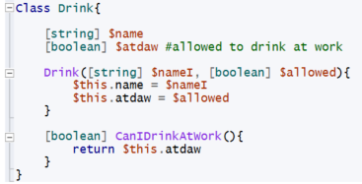
Object Creation
There are many ways to make objects depending on the language being used. However, the most common of these methods is the use of a class
Classes are Collections of code that are named and can be referenced and instanced
Classes can be thought of as the framework for an object, with similar values, methods, and constructors
Example of a Class:
Class Declaration
Class Variables
Class Constructors
Class Methods

Slide 12
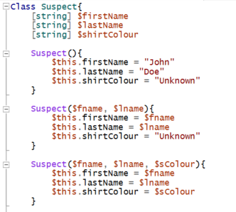

Object Creation (Constructors)
Constructors are the code run when an object is created
A single class can have multiple constructors
Constructors share the same name as the class
Depending on the information available or the intended actions different constructors are called
Constructors are differentiated by the parameters being passed into them
Constructor 1
Constructor 2
Constructor 3
Constructor 1
Constructor 2
Constructor 3

Slide 13

Object Creation (Class Variables)
Class Variables are the values within a class that are initialised and shared between all instances of a class
These values can be different between different instances of classes
Using the information above we can see that there are three suspect classes that were created. Each of which stores different values into their class variables
To access these values we can use the “.” operator

Slide 14
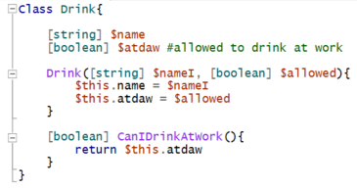
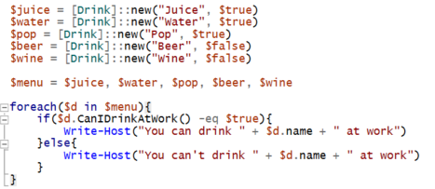
Object Creation (Class Methods)
Class methods are set the same as you would make a method outside of a class. These classes are sets of code that can be run for any instance of a class.
In the example above, the method “CanIDrinkAtWork()” returns the value that is saved in the class variable “atdaw”
To call the method we use the “.” operator

Slide 15
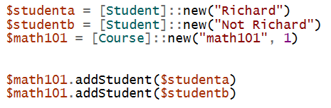
Object Example (Course Registration) I
This example uses classes to create a simple course registration abstract
The goal is to make a class for a course and for a student
Each course has a name, number of students, and class size
Each student has a name and list of courses they are signed into
There should also be a way to add a student to a course
Using the code below we should get this output

Slide 16
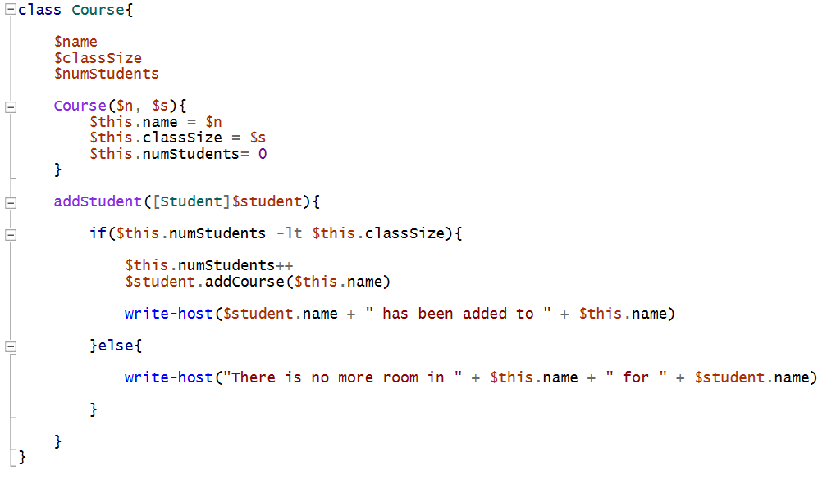
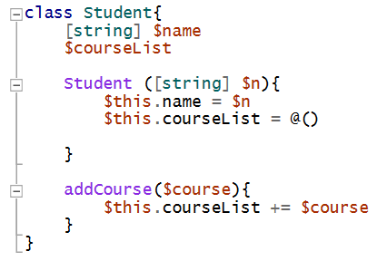
Object Example (Course Registration) II

Slide 17
Object Example Review
The example can be separated into three steps:
1. Determine what global variables to have
2. Determine what constructors to make
3. Determine what methods to create
In this example the class descriptions were already defined, so all we had to do was fill in the classes
From the code, we can see that the constructor for the student only took a name, and the one for a course took a name and number(Class size)
To add a student a method was called in the class to add a student and took the student as a parameter
As these examples are becoming too long, they will be in supplied files

Slide 18
Object Exercise
In the provided files there will be an exercise with several partly built classes. Please read the comments and complete the classes where necessary to make the code work as intended.
The example works around albums and artists, follow the test class to do the exercise

Slide 19
Programming Basics Complete
You should now be able to apply your knowledge to make scripts, programs, and go out to learn more to become a fully equipped programmer.
Congratulations and happy programming

